Slide 1
Candy Sales Analysis
physical ‘FMCG’ store in the period of 2 years

Slide 2
AGENDA :
Identify the key factors that are impacting the purchases of chocolate candy bars. Work on the data and generate actionable insights.
CONCULSION :
Show which are the main factors effecting in purchase of Candy Sales
Tools :
SQL is used to Show the data in the table format.
Excel is used to Show the data in the Visual representation.

Slide 3
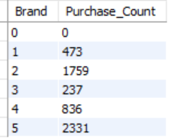
What is the relationship between purchase incidence and brand
0 is meant by No Brand
1 is meant by Brand 1
2 is meant by Brand 2
3 is meant by Brand 3
4 is meant by Brand 4
5 is meant by Brand 5
By Observing the data we Can See the sales of the Brand 3 Candy are Having very less Sales and Brand 5 Candy has Very Highest No of sales .
Brand 2 Candy has the Good No of sales.
Brand 1 Candy and Brand 4 Candy has Average No of sales .

Slide 4
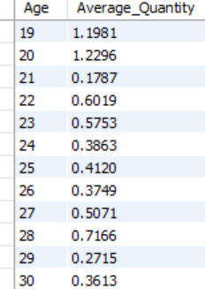
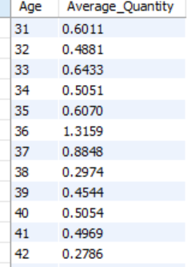
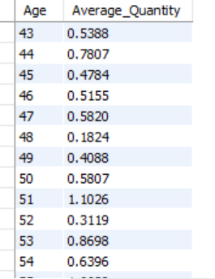
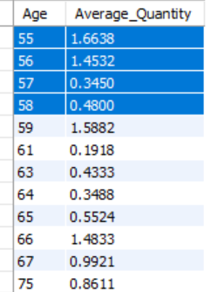
Does the quantity of candy purchased by a customer increase or decrease with their age?
By Observing the Data on average the Age Group Between 50 to 60 people more
Like to buy the Candy.
Later the age Between 19 to 30 People more Slightly interested to by the candy
From the age Group 31 to 49 are Show Very Less interest to buy the candy

Slide 5
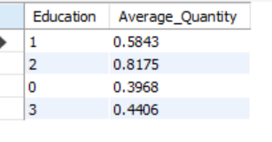
How does the level of education of a customer affect their purchase behavior?
0 - Other/ Unkown
1 - High School
2 - University
3 - Graduate School
By Observing the data we can say that People from the University are By more
Compare to the Other
Where is the Graduate School have the purchase of sales are very less .

Slide 6
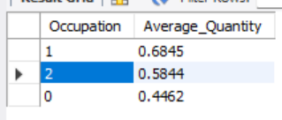
Are there any differences in candy sales based on the occupation of the customer?
0 - unemployed / unskilled
1 - skilled employee / official
2 - management / self-employed / highly qualified employee / officer
Here we can see that Every Occupation type are Very Much Interest to Buy the candy.

Slide 7
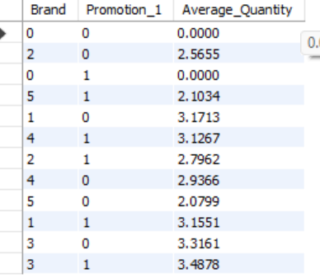
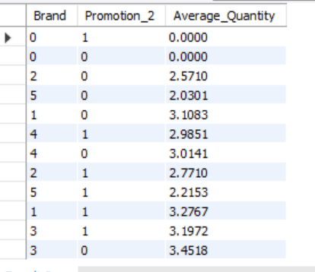
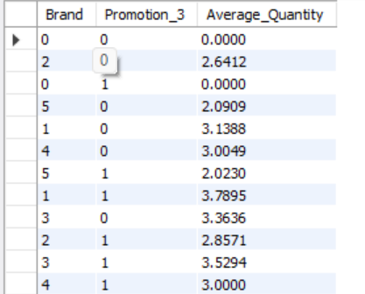
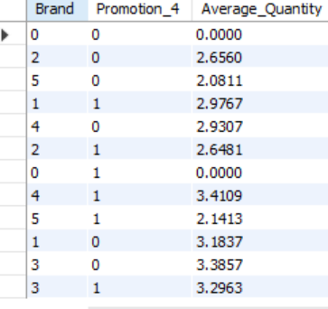
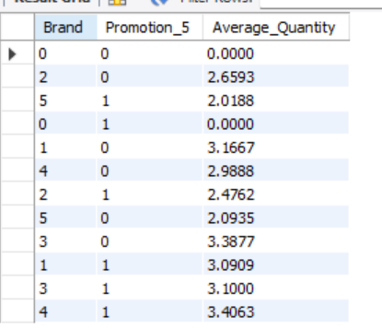
What is the effect of promotions on candy sales in terms of both quantity and brand
Here we Have type of promotions which are very help full in the sales of the candy, Every type of the Promotions are Help in selling of the candies .
Comparing all the Type of Promotions , Promotion_4 and Promotion_5 are Very Effective in the Selling of the candy
Remaining Promotion 1 , Promotion 2 and Promotion 3 are Given less Impact to the Selling of the Candy

Slide 8
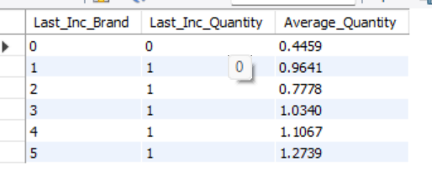
How does the last incidence brand and quantity affect the current candy sale
0 is meant by No Brand
1 is meant by Brand 1
2 is meant by Brand 2
3 is meant by Brand 3
4 is meant by Brand 4
5 is meant by Brand 5
The Repeated Customer Who are Visted to Buy the Candy , Where They are Show Much interest to Buy the Brand 5 Candy
Where For the Brand 1 and Brand 2 ,The Customer are Show Very Less Interest
Where For the Brand 3 and 4 are Also Have the Good Attracted the Previous
Customers .

Slide 9
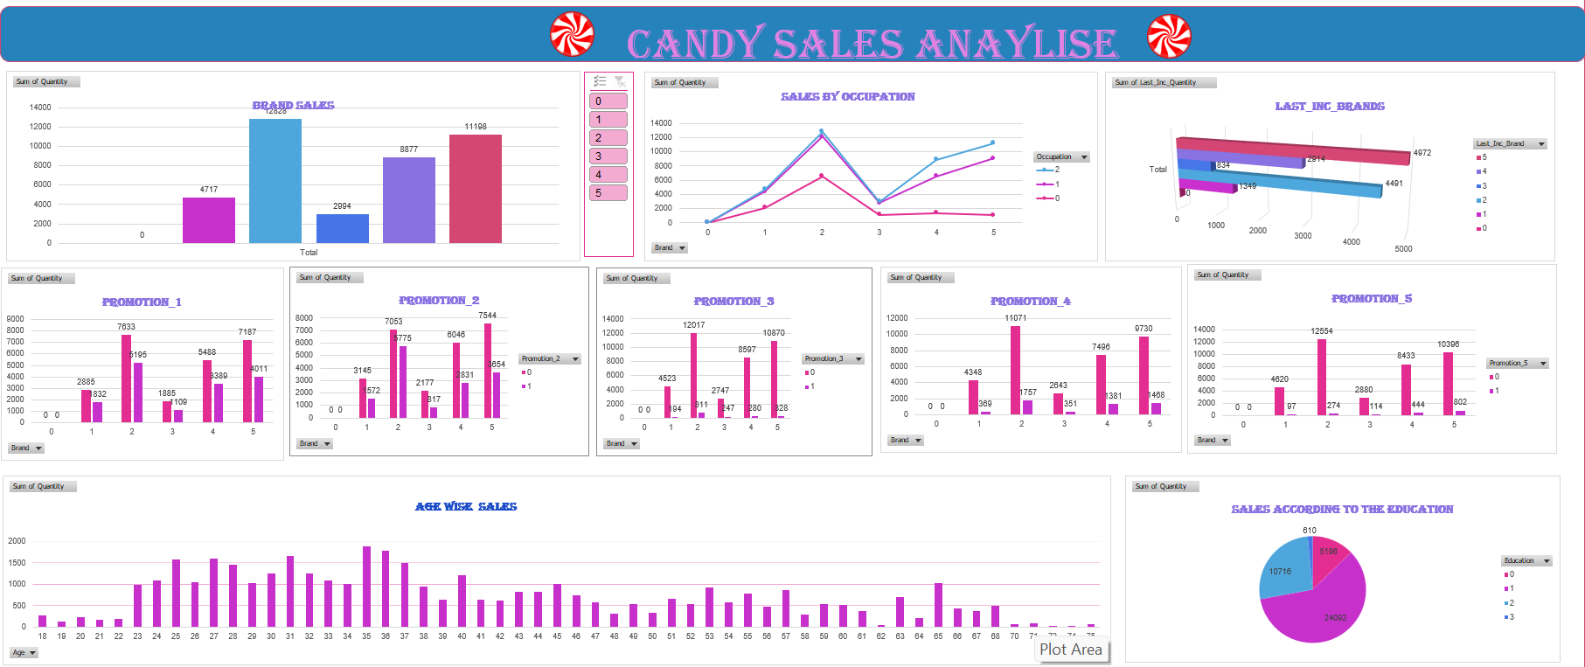

Slide 10
Observation
The Company need to Look the Brand 1 Candy and Brand 3 Candy Are Showing very Less productivity Compare to the All Brands .
Company Need to More Concentrate on the Age Group Between the 31 to 49 .
Sales of Candy in the Graduate School are very Less .
Promotion _4 And Promotion _5 Shown Very Much Effective result in selling of the Candy .
Conculsion
Where Brand 5 Candy’s Are Show very Good Sales and Promotion are Also Very Help full in Selling of the Candy ,Company need to More Concrate on the Middle age Group of People and Need Do Changes for the Brand 1 and Brand 2 Candy .

